Slide 1

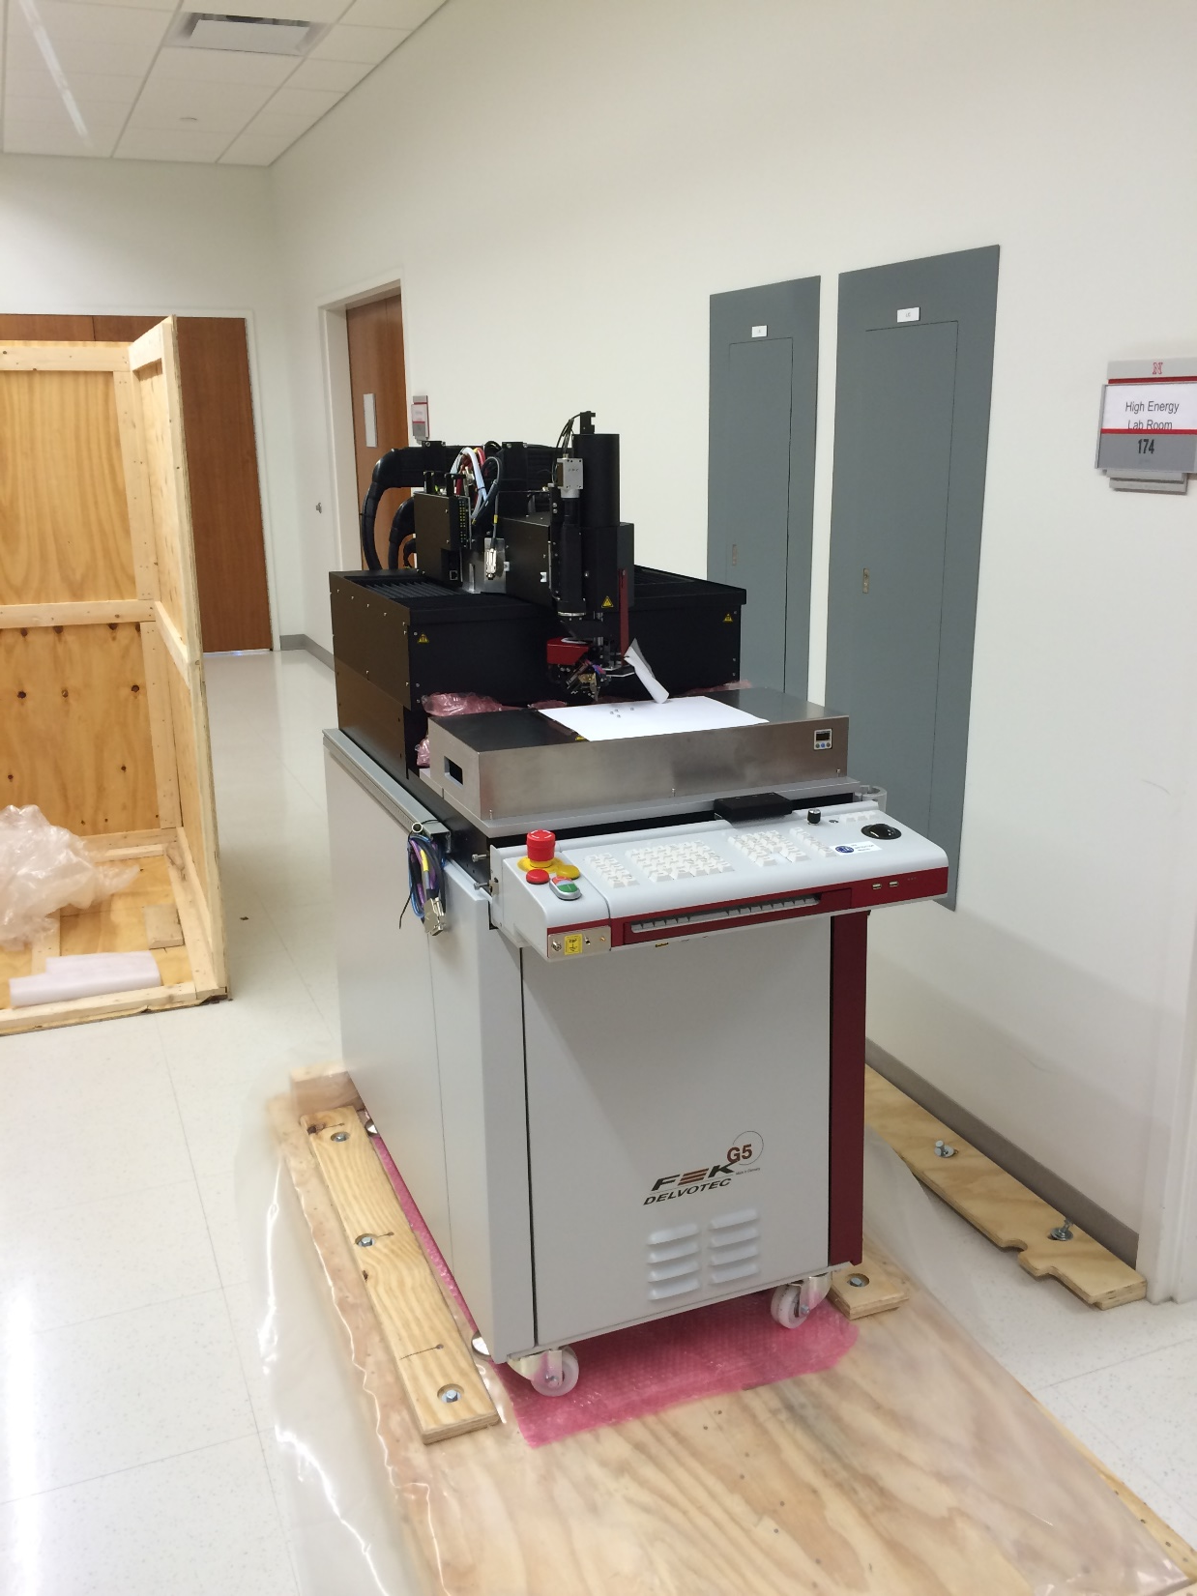

Slide 2
Two major wire bonding types: Ball and Wedge
Wedge bonding – application of ultrasonic power and force to form bonds
45 degree wedge angle feed with 2 mil diameter hole. 25.4 micrometers = 1 mil
25 micrometer diameter aluminum wire, 400 feet per spool @$167
Aluminum Silicon (1%) wire EL: 1-4% BL: 15-17 gm

Slide 3
Example wedge tool end for AL wire

Slide 4
45 degree feed

Slide 5
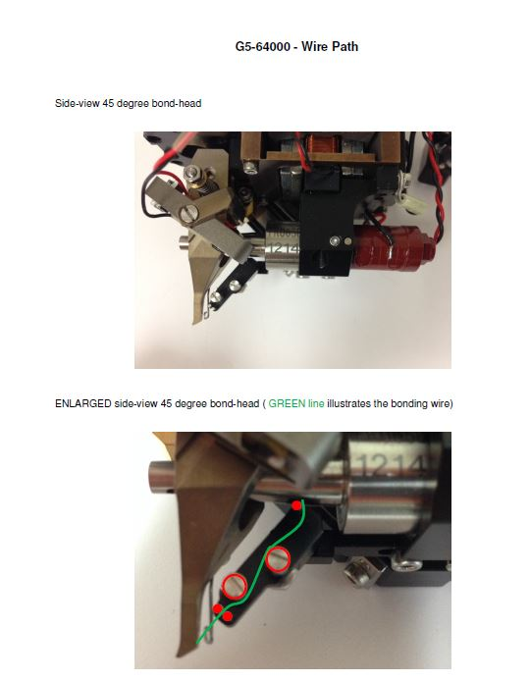

Slide 6
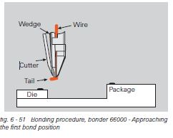
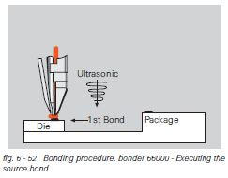
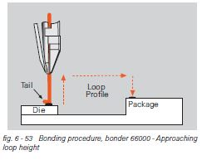
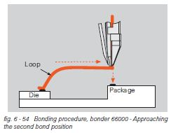
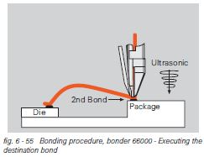

Slide 7
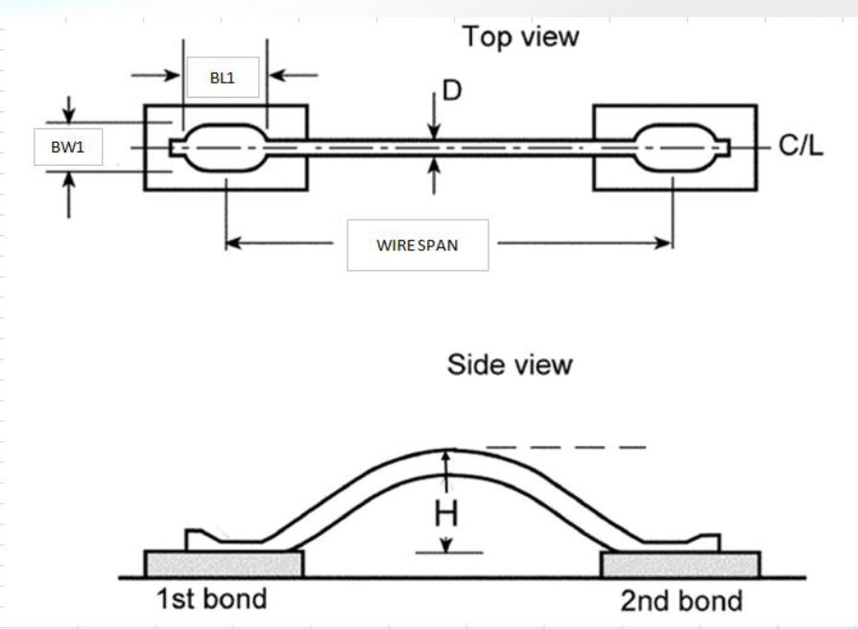
Anatomy of a Good Wedge Bond

Slide 8
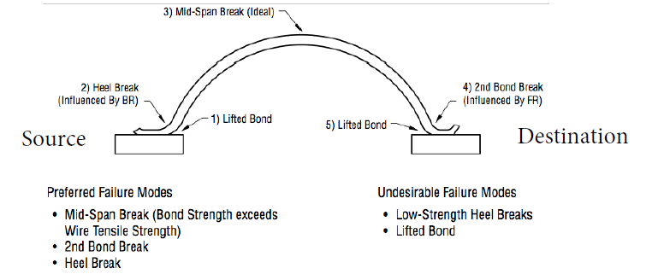

Slide 9
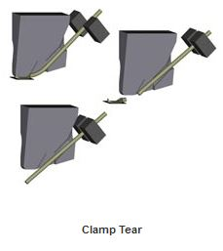

Slide 10
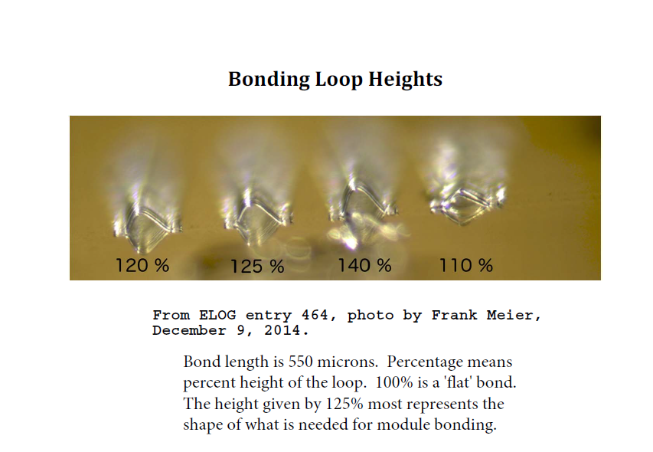

Slide 11
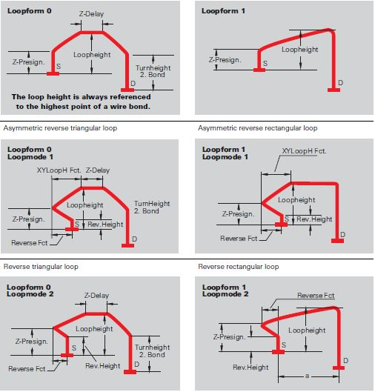
Types of loops:

Slide 12
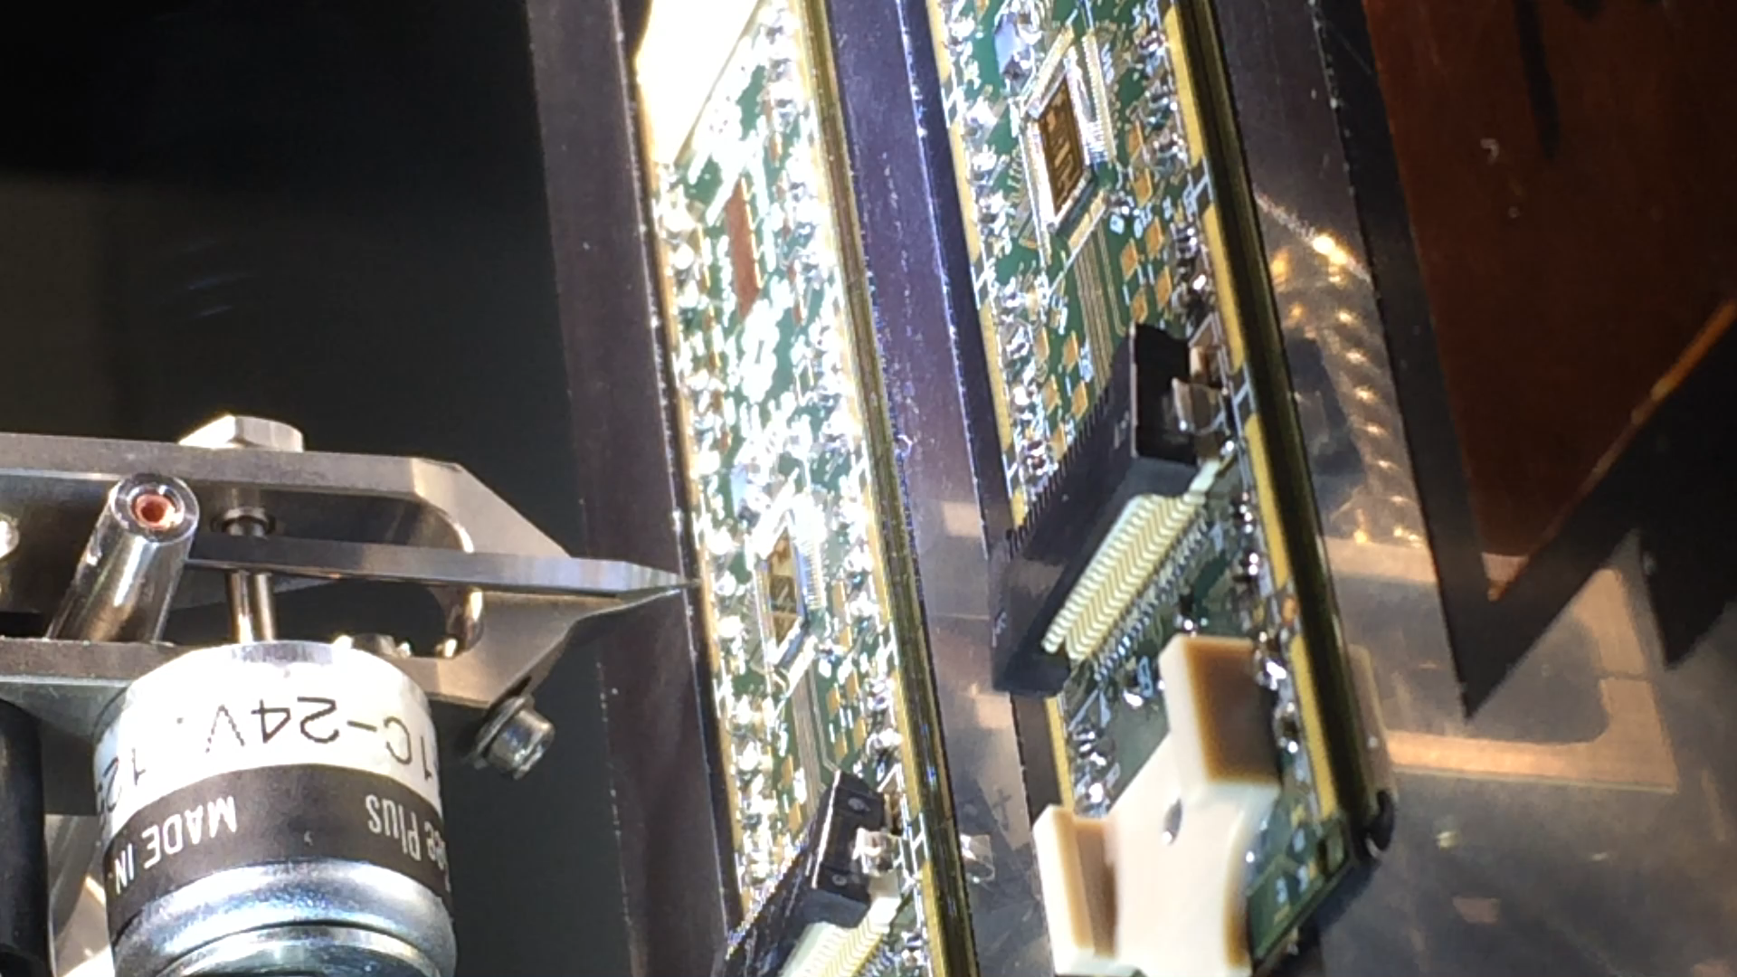
Wire bonding on the F&K Delvotec 5630

Slide 13
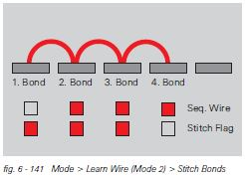
Stitch Bonds

Slide 14
